Slide 1

Predict New York City Taxi Demand
Capstone Project Big 4 Team 17/09/2016

Slide 2




Big 4 Team
Shuo Zhang
Bin Fang
Jingyu Zhang
Yunrou Gong
PHD Chemical Engineering
PHD Electrical Engineering
Master Operational Research
PHD GIS

Slide 3
Content
Introduction
Data Pre-processing
Modeling Workflow
Exploratory Data Analysis
Modelling
Ensemble
Prediction
Future Work

Slide 4
Introduction
Purpose: predict the number of taxi pickups given a one-hour time window and a location within NYC
how to position cabs where they are most needed
how many taxi to dispatch
how ridership varies over time
Input: Date, one-hour time window,
and zipcode within NYC
Output: Predicted number of taxi pickups at the input time and location Output: Predicted number of taxi pickups at the input time
Output: Predicted number of taxi pickups at the input time and location

Slide 5
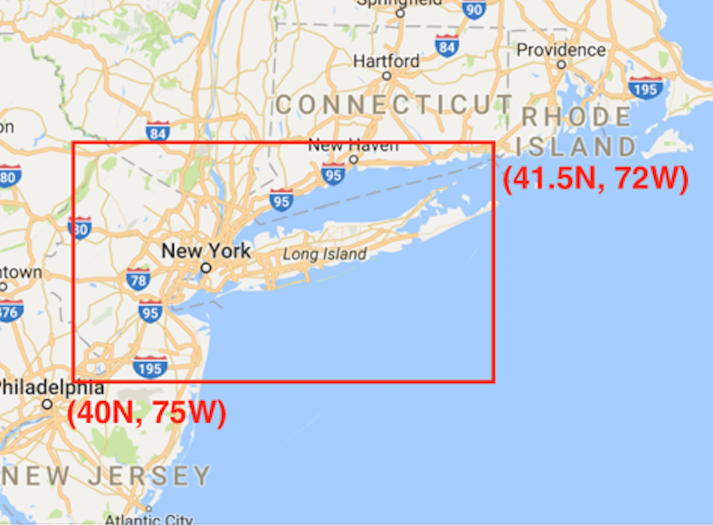
Data Preparation
Raw
Data
~14G
Yellow
12.5G
Green
1.2G
Uber
0.22 G
Weather
0.001G
Feature selection
~1billion
Data Cleaning
Lon,lat-->zipcode
Geocoding
120,000
Dimension reduction
~1 billion
Aggregation
~ 60,000
Data Sets
~ 71,000*5

Slide 6
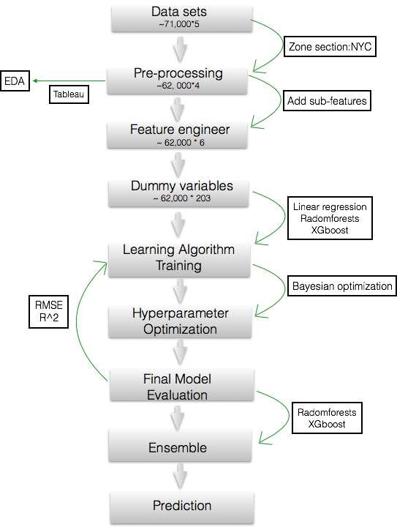
Modeling Workflow

Slide 7
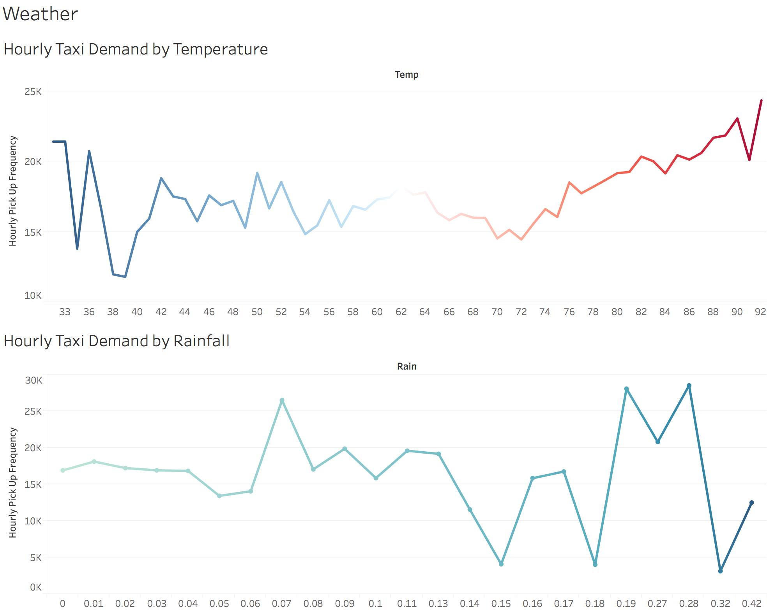
EDA (Tableau)

Slide 8
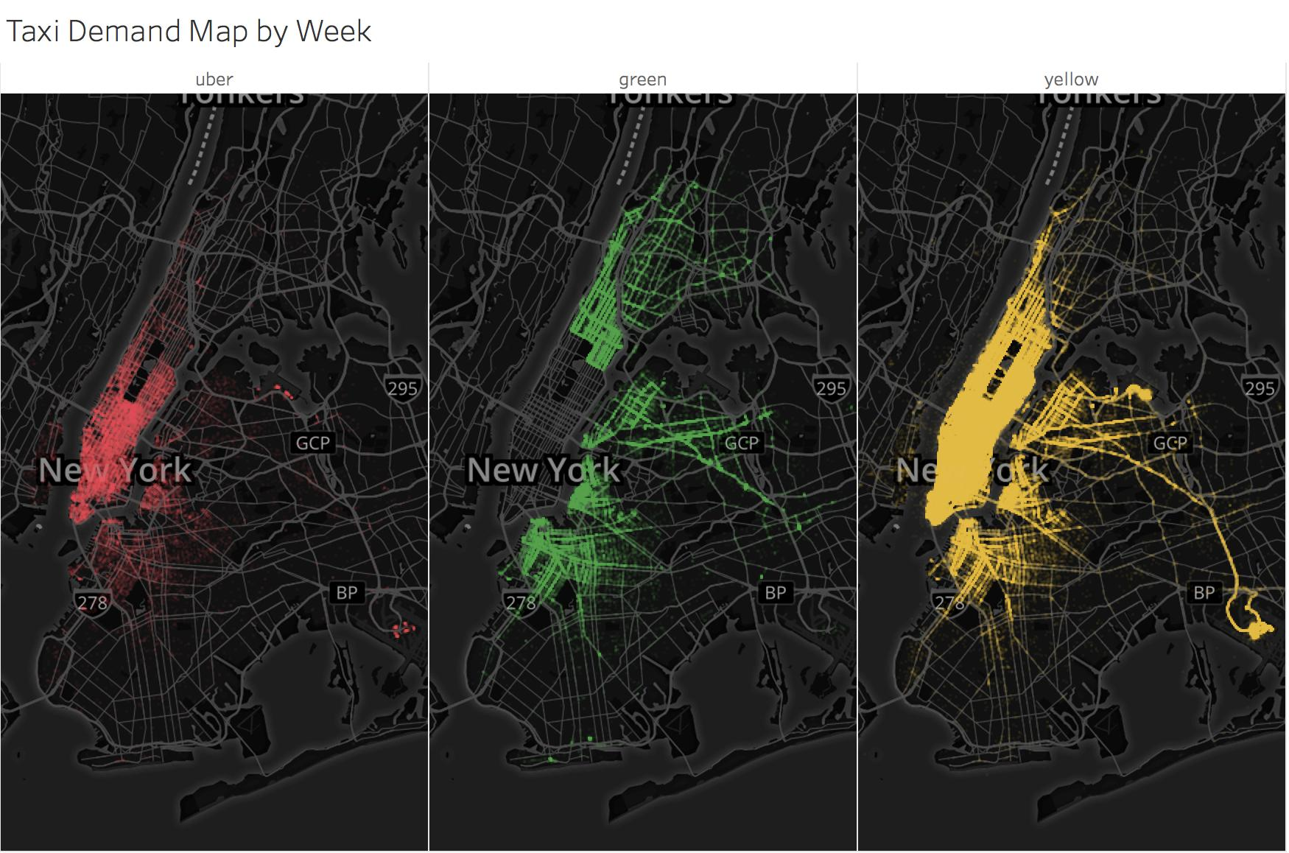
EDA (Tableau)

Slide 9
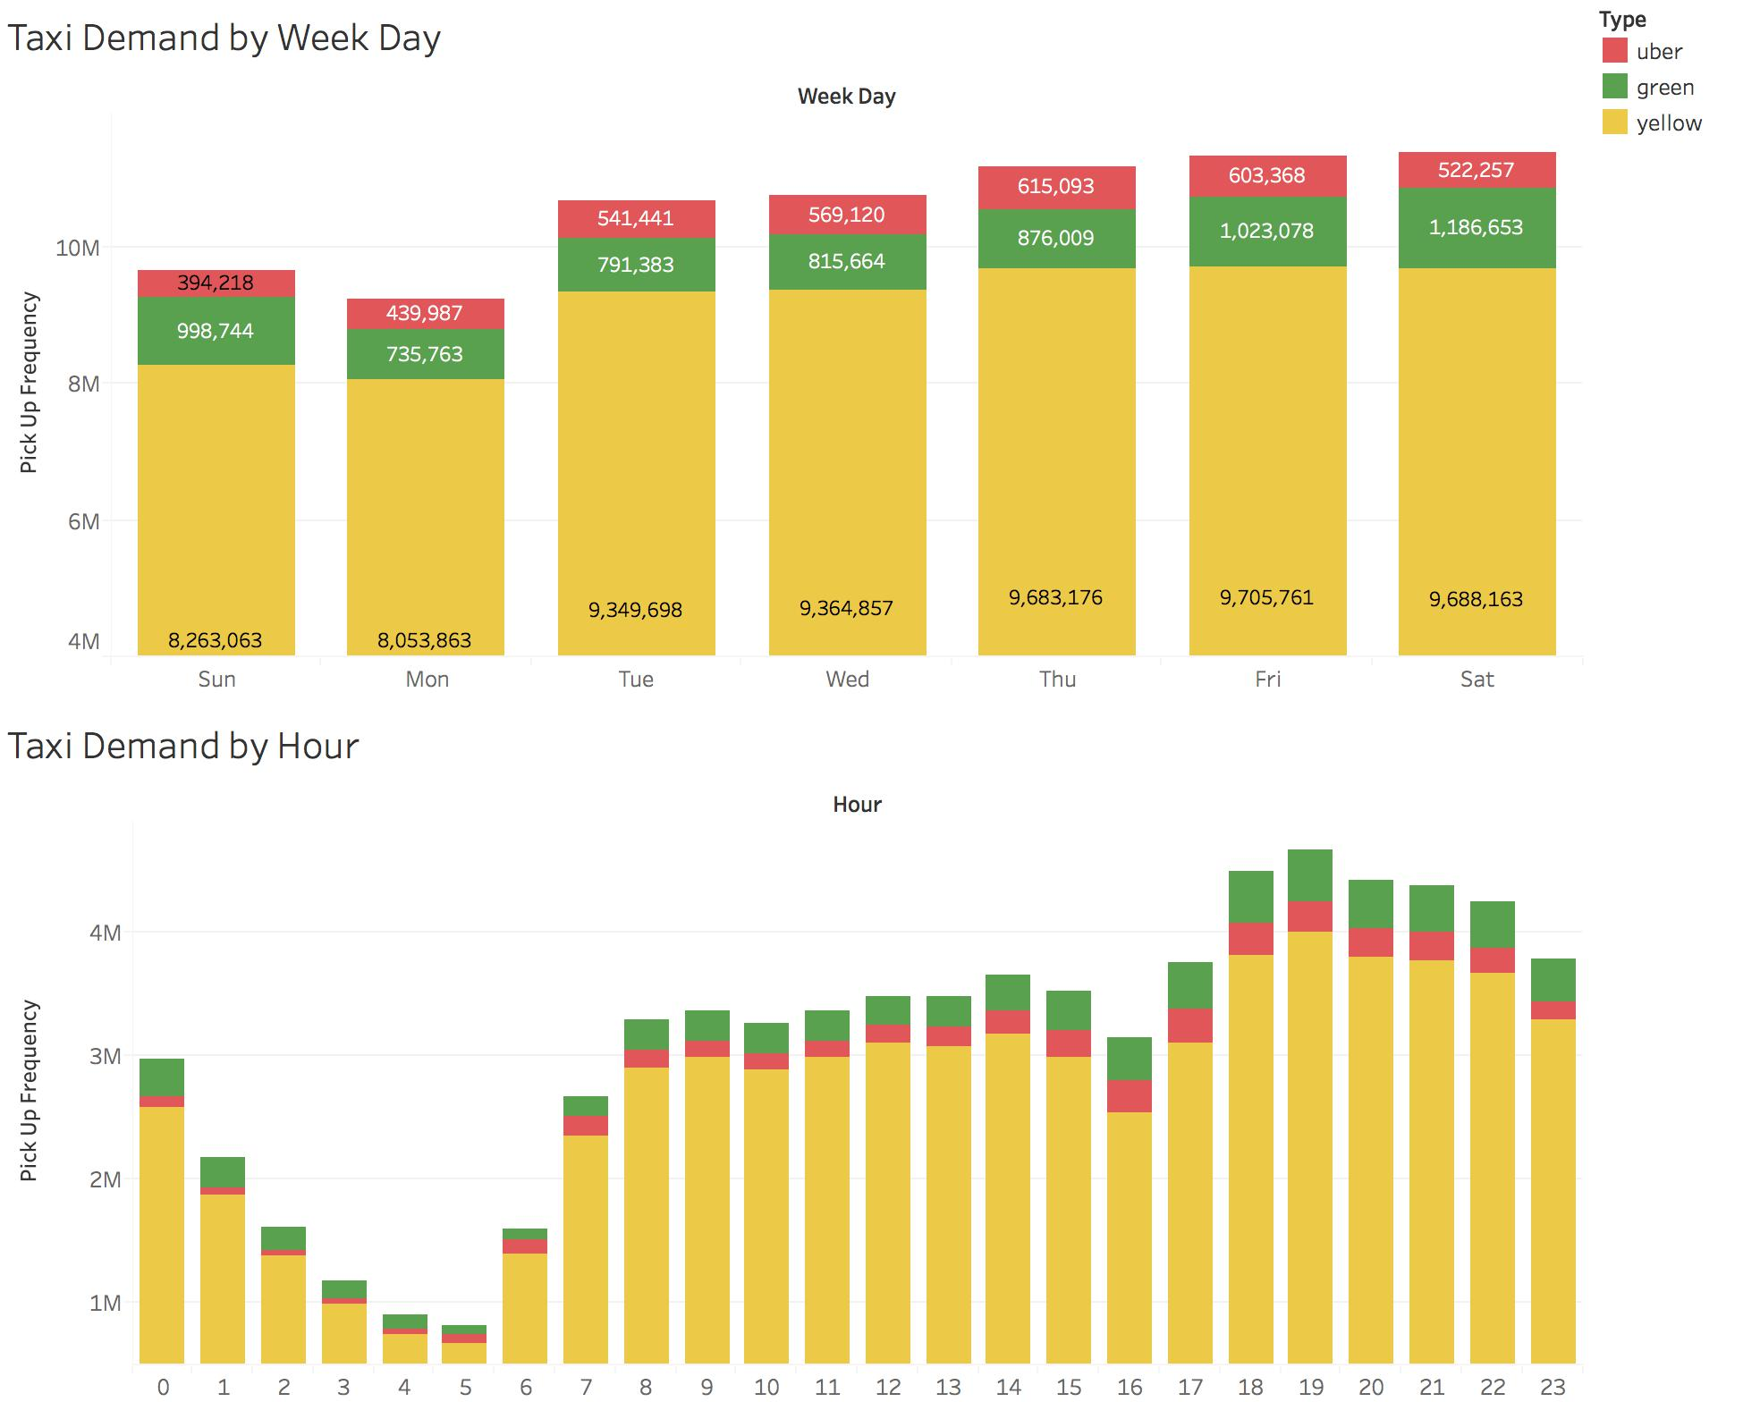
EDA (Tableau)

Slide 10
MLR and Ridge Regression
Multiple-linear Regression
Train
R^2: 0.75
RMSE: 127.35
Test
R^2: 0.76
RMSE: 125.56
Ridge Regression
Bayesian Optimization
12 iteration to find best alpha
Train
R^2: 0.75
RMSE: 127.34
Test
R^2: 0.75
RMSE: 125.56

Slide 11
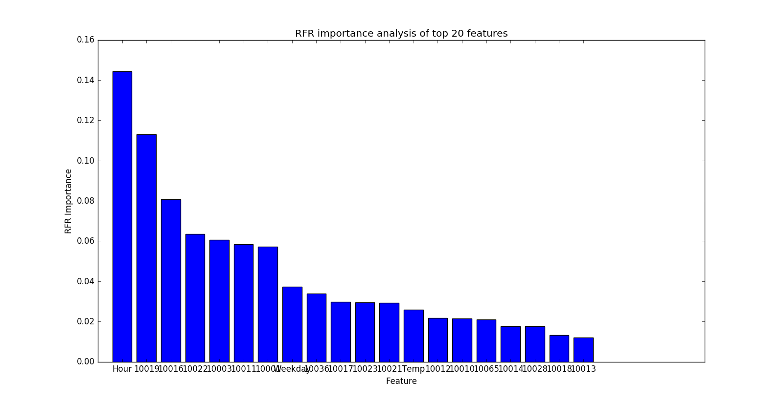
Random Forest
RandomForests
Bayesian Optimization
2 iteration to find best max_features and n_estimators
Test
R^2: 0.97
RMSE: 40.60
Train
R^2: 0.99
RMSE: 16.05

Slide 12
XGBOOST
Parameters | Range | Best (lowest MSE)
Max_depth | 3 ~ 14 | 14
Learning_rate | 0.01 ~ 0.2 | 0.1186
N_estimators | 50, 1000 | 463
gamma | 0.01 ~ 1.0 | 1.0
Min_child_weight | 1 ~ 10 | 6.1929
Subsample | 0.5 ~ 1 | 0.9675
Colsample_bytree | 0.5 ~ 1 | 0.8544
XGBOOST
Bayesian Optimization
30 iteration to find best parameters combination
Test
R^2: 0.98
RMSE: 35.01
Train
R^2: 0.99
RMSE: 21.85

Slide 13
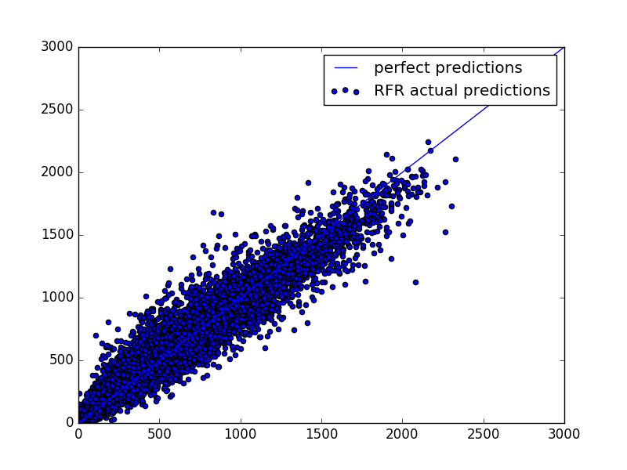
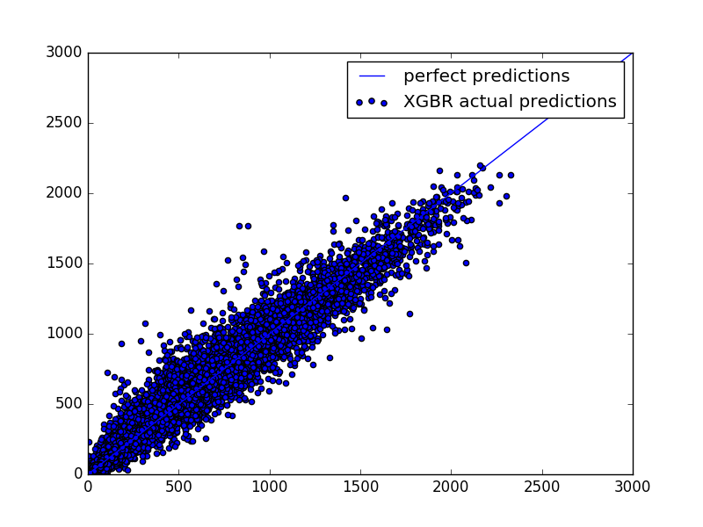

Ensemble
RandomForests Regression
Xgboost Regression
Ensemble (Linear Regression)
Predicted number of pickups
True number of pickups
Model | R^2 | RMSE
MLR | 0.76 | 125.56
Ridge | 0.75 | 125.56
RFR | 0.97 | 40.06
XGBR | 0.98 | 35.01
Ensemble | 0.97 | 42.95
Predicted number of pickups
Predicted number of pickups
True number of pickups
True number of pickups

Slide 14
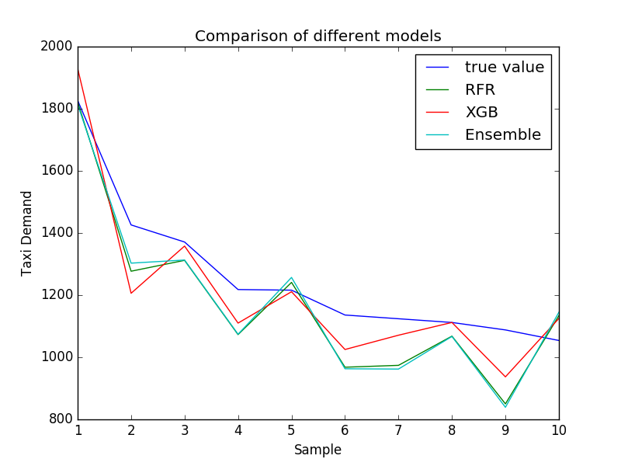
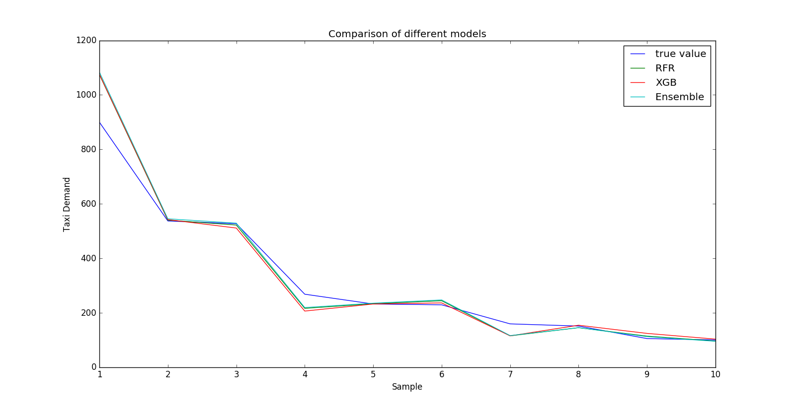
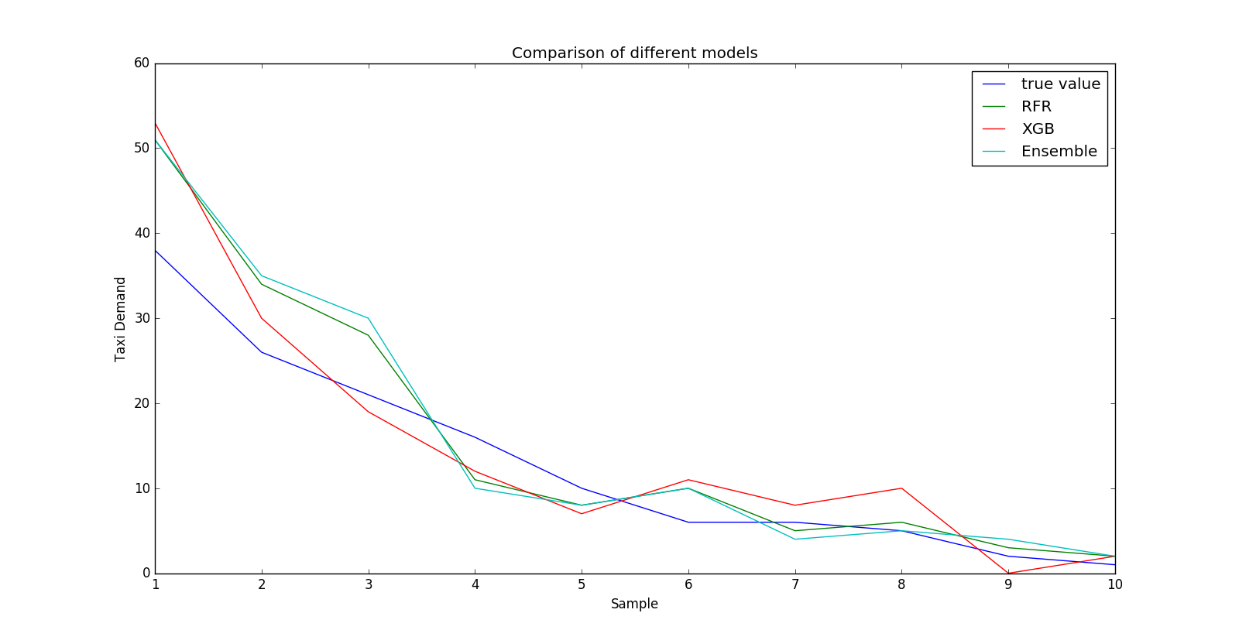
Further Comparison of Models
Subset | Demand | Size | RFR RMSE | XGBR RMSE | Ensemble RMSE
Subset 1 | >=1000 | 2479 | 150 | 123 | 156
Subset 2 | 100 ~ 999 | 24759 | 75 | 66 | 80
Subset 3 | <100 | 95472 | 8.7 | 7.2 | 9.5

Slide 15
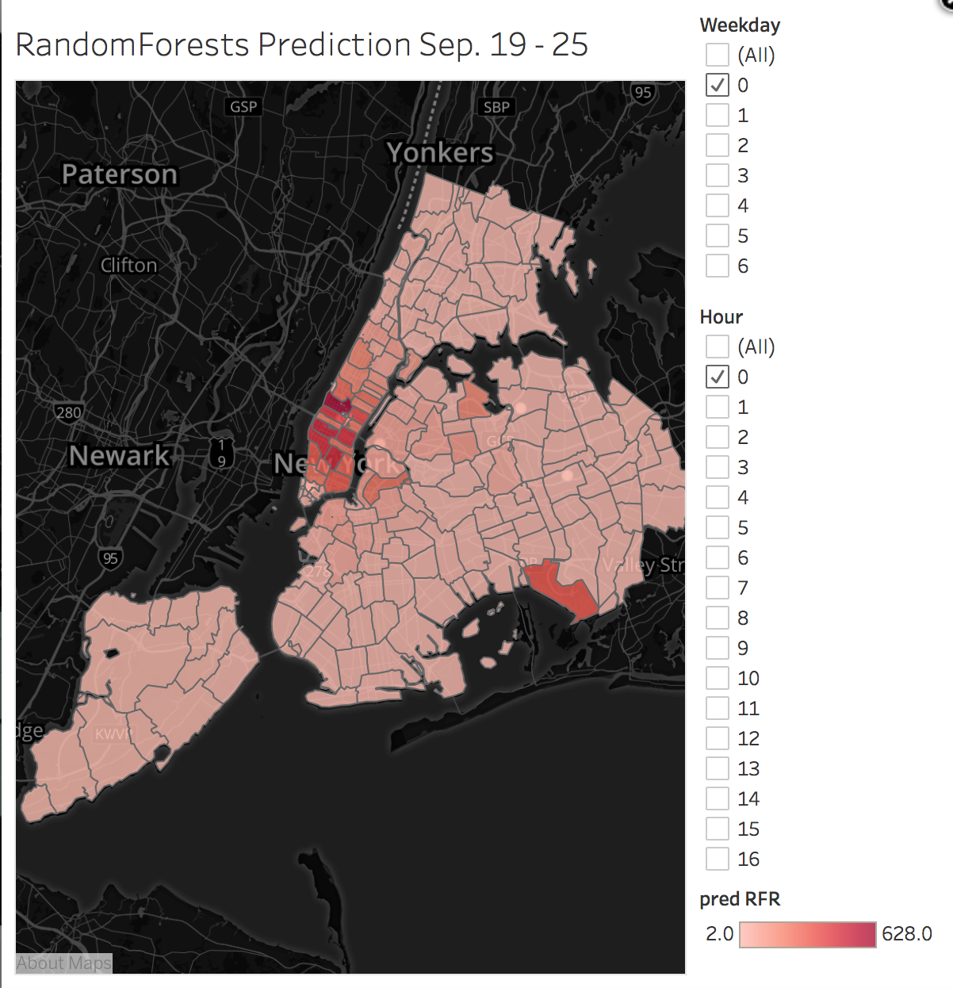
Prediction for the Coming Week
RandomForest
XGBOOST
Ensemble

Slide 16
Conclusion & Future Work
Overall, our models for predicting taxi pickups in NYC performed well.
^{XGBOOST performed best.}
^{Neutral network:}
automatically tune and model feature interactions
^{learn nonlinearities}
^{Extra features:}
distance to the nearest subway station, the number of bars and restaurants in a given zone
^{K-means clustering}
Exploit similar characteristics between different zones

Slide 17

Thanks for your time
QUESTIONS?

